Slide 1
Web Services (Rest)

Slide 2
What is REST?
REST:
Representational State Transfer
Rest is an architectural style
REST is about resources and how to represent resources in different ways
REST is about client-server communication
RESTful systems have Six Architectural Constraints, that give the service desirable properties such as scalability, simplicity, portability, reliability
Notes:
REST or Restful webservices are one way of providing interoperability between computer systems on the internet.
Architectural style – to design networked applications

Slide 3
REST: Architectural Constraints
1. Client-Server
Clients are not concerned with data storage, which remains internal to each server, so that the portability of client code is improved.
Servers are not concerned with the user interface or user state, so that servers can be simpler and more scalable.
Servers and clients may also be replaced and developed independently, as long as the interface is not altered.

Slide 4
REST: Architectural Constraints
Stateless
Essentially, what this means is that the necessary state to handle the request is contained within the request itself, whether as part of the URI, query-string parameters, body, or headers.
Every client request has enough information for the request to stand independent of other requests. Only the client knows (or could ever need to know) the session state.
Cacheable
As on the World Wide Web, clients can cache responses. Responses must therefore, implicitly or explicitly, define themselves as cacheable, or not, to prevent clients reusing stale or inappropriate data in response to further requests.
Well-managed caching partially or completely eliminates some client–server interactions, further improving scalability and performance

Slide 5
REST: Architectural Constraints
4. Uniform Interface: Simplifies and decouples the architecture, enabling each part to evolve independently. There are four guiding principles to Uniform Interface
Resource Based
Manipulation of Resources through Representations
Self-descriptive Messages
Hypermedia as the Engine of Application State
5. Layered System
A client cannot ordinarily tell whether it is connected directly to the end server, or to an intermediary along the way. Intermediary servers may improve system scalability by enabling load-balancing and by providing shared caches.
Layers can be used to ensure server security.
Notes:
Resource Based
Individual Resources are identified in requests using URIs (Uniform Resource Identifiers).
Resources are distinct from the representations returned to the client.
Manipulation of Resources through Representations
A client has enough information to modify or delete resources on the server, provided it has permission to do so.
Self-descriptive Messages
Every message includes enough information to describe how to process the message
Hypermedia as the Engine of Application State
Clients deliver state via body contents, query-string parameters, request headers and the requested URI (the resource name). Services deliver state to clients via body content, response codes, and response headers. This is technically referred-to as hypermedia

Slide 6
REST: Architectural Constraints
Code on Demand (optional)
This is the only optional constraint, every other constraint is necessary for a system to be considered RESTful
Servers can temporarily extend or customize the functionality of a client by the transfer of executable code.
Complying with these constraints, and thus conforming to the REST architectural style, will enable any kind of distributed hypermedia system to have desirable emergent properties, such as performance, scalability, simplicity, modifiability, visibility, portability and reliability.

Slide 7
Why REST?
REST is a simple, lightweight alternative to bulkier webservices like SOAP, WSDL
Feel free to read into REST and SOAP more, these are good topics to explore and can be talked about during some of your projects.
Furthering this, REST is not a standard, and there will likely never be a “standard” in W3C (World Wide Web Consortium), but most people find it a great way to produce scalable, responsive services.
REST is full featured.
You can do just about anything with REST that you can do with other Web Services, though some actions may be easier or faster to implement through other means due to the lightweight nature of REST.

Slide 8
HTTP Verbs
HTTP Verbs provide the action for our noun-based resources. They are used for many objects, and can be used for many nouns.
We use four main verbs, GET, PUT, POST, and DELETE. These are not the only verbs, OPTIONS and HEAD are probably used the next most frequently, and there are some other HTTP verbs out there too.
Think of an HTTP verb like you do a verb in standard english. It lets us provide action to an object or data.
We can GET ice cream from the freezer just as easily as we can GET our charger for our laptop. Two different objects have the same verb associated with them.

Slide 9
GET, PUT, POST, DELETE
GET
GET is used to READ.
GET requests read data without changing it. When they are used this way, they are considered to be safe, as the request cannot modify or corrupt the data.
Because of this, GET should NEVER modify any resources on the server. Never, ever.
Put all this together, and we find that GET is idempotent, or the result of calling get will not change if called identically over and over.
PUT
PUT is used to UPDATE.
PUT is not safe. But it can be idempotent and it is strongly recommended you let PUT remain idempotent (use POST for non-idempotent requests)
If you update or create a resource with PUT, then make the same call again, it should have the same state as before. PUT can be non-idempotent if you use it to increment or something like that, but don’t do that because you won’t be cool if you use it that way.

Slide 10
GET, PUT, POST, DELETE
POST
POST is used to CREATE.
POST is neither safe nor idempotent. Calling it twice will likely result in two resources containing the same information.
Submits data to be processed to a specific resource. Use POST when the server or service is in charge of deciding the URI for the newly-created resource.
DELETE
DELETE is used to DELETE (Seems straight-forward enough, right?).
DELETE can be idempotent and it is recommended you use it that way. But this has a caveat
Using it idempotently: Use it not to decrement, but to remove a resource. If you remove a resource, then remove it again, the end result of both will be the same.
The Caveat: If you DELETE a resource twice, the second call will likely return 404 (NOT FOUND). So it really isn’t idempotent, but it is close. We’re compromising with the term idempotent here, though it can be idempotent if you do it right.

Slide 11
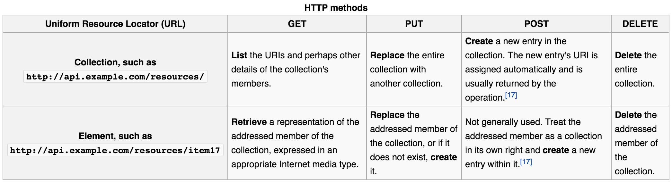
GET, PUT, POST, DELETE

Slide 12
What is API?
Application Programming Interface:
An API (Application Programming Interface) is best thought of as a contract provided by one piece of computer software to another.
Pieces of software can interact with or without an API.
Without API: An app finds the current weather in London by opening http://www.weather.com/ and reading the webpage like a human does, interpreting the content.
With API: An app finds the current weather in London by sending a message to the weather.com API (in a structured format like JSON). The weather.com API then replies with a structured response.

Slide 13
In the lab, you’ll use...
jq: Essentially, jq processes (filters) JSON files. JSON stands for JavaScript Object Notation. JSON provides notation for data that both people and computers can read easily
https://stedolan.github.io/jq/ ← If you wanna know more.
API: You’ll be using the API for darksky.net. API lets developers utilize services without having to do a bunch of research. We all like good API and good code commenting, however rare they might be.

Slide 14
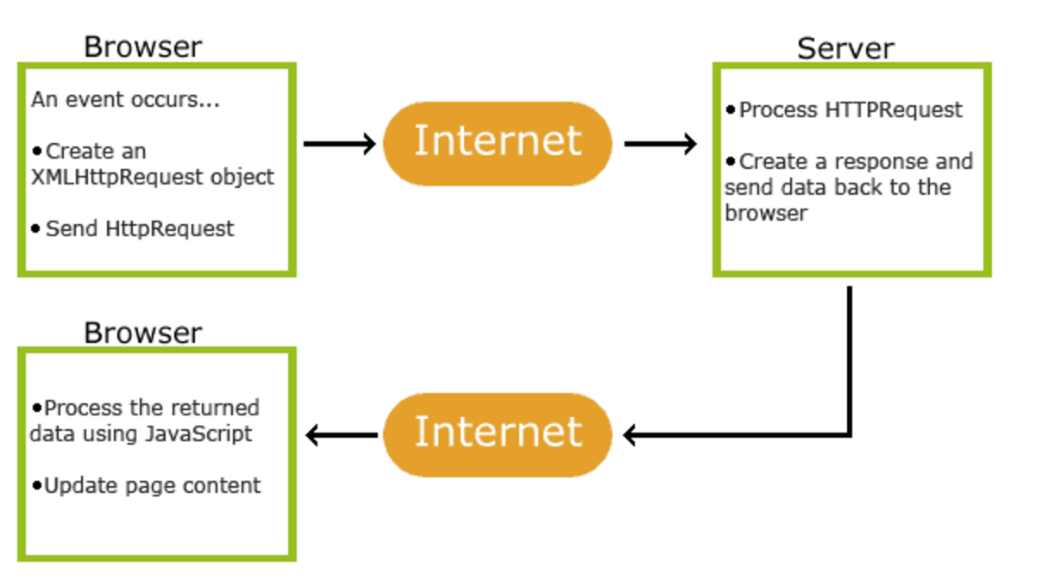
In the lab, you’ll use… AJAX
Source:
http://www.w3schools.com/xml/ajax_intro.asp

